Slide 1
Is There a Rule for That?
Client Webinar Series
Time to Reach New Heights
February 9, 2017

Slide 2
Agenda
First Objective: Increase Comfort Level with Rules
Understanding Rule Groups
How to get information from the ? Icon
Using the rule KBAs on support.spitfirepm.com
Index of Rule Groups
Ctrl + F
Using the Rules Maintenance Tool
What the Warning symbol means
Using filters
How to add and edit rule configurations
Understanding Code-based Rules

Slide 3
Agenda
Second Objective: Explain Some New V2016 Rules
FileCatalogConfig | AutoLockAttachments
RouteConfig | ShowMaximized
RouteConfig | ThumbUpDismissSeconds
DocTypeConfig | EmailShortID
DocTypeConfig | ExpressDocAttachList
ProjectConfig | InferValueFromBudget
EmailText | NotifyOver and NotifyUserOver
DocItemConfig | DefaultRevisionNumber

Slide 4
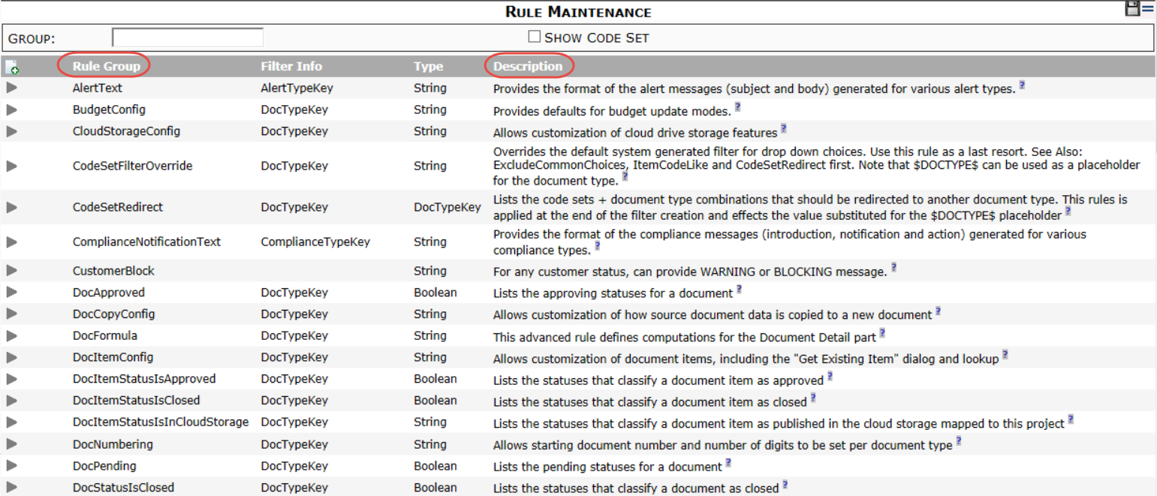
Rule Groups
Rules are organized into Rule Groups

Slide 5
The ? Icon
Click the ? Icon to get information about that rule group.
The ? icon is also available when you expand a rule group.

Slide 6
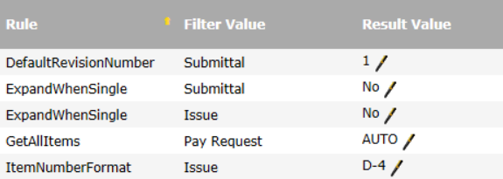
Parts of a Rule
Rule Name – the specific rules within a rule group.
Filter Value – what the rule applies to. Often Doc Type. Not all rules accept a Filter Value.
Result Value – the specifics that tell a rule what to do.

Slide 7
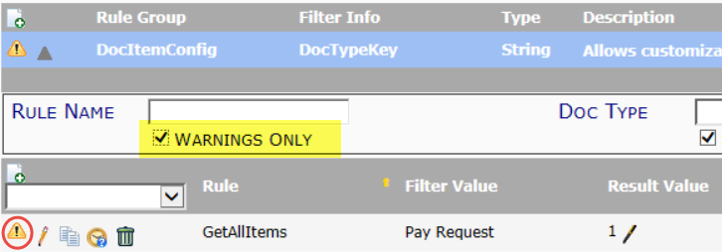
The Warning Symbol
The warning symbol indicates that a rule group has an invalid rule.
The warning symbol indicates that a specific rule has an invalid filter or result value.
Filter for all rules with warnings.

Slide 8
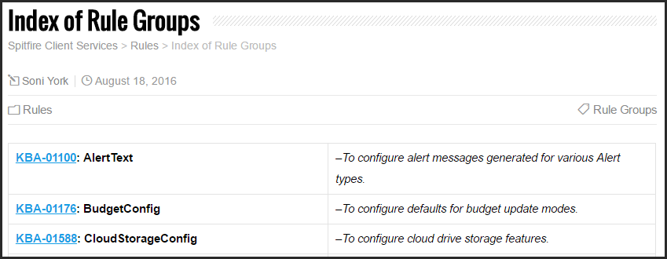
Support.spitfirepm.com
Our Spitfire Client Services website has the KBAs for all the rule groups
Use the Category of Rules
Use the tag of Rule Groups or Rules
Use the Index of Rule Groups

Slide 9
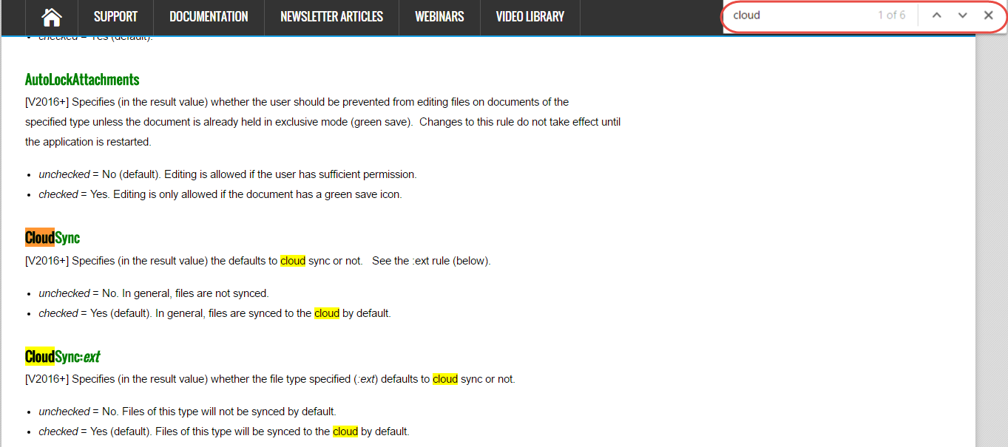
Rule-Based KBAs
Scroll to read specifics of each rule or
Use CTRL + F to search within a KBA.
Green text means “new to the latest version.”

Slide 10
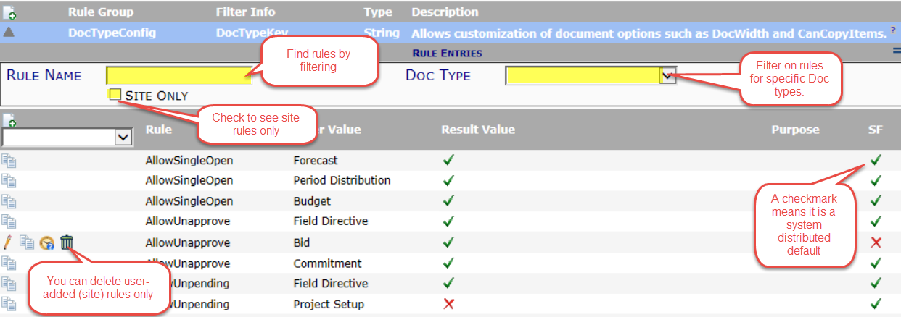
Rules Maintenance Tool
Where rules are listed and changed

Slide 11
3 Ways to Configure Rules
Copy a system-distributed rule then edit it.
Edit an existing user-added rule.
Select the rule name then click the “Add” icon to add a new row. Select the filter value and add a result value (and Purpose if desired).

Slide 12
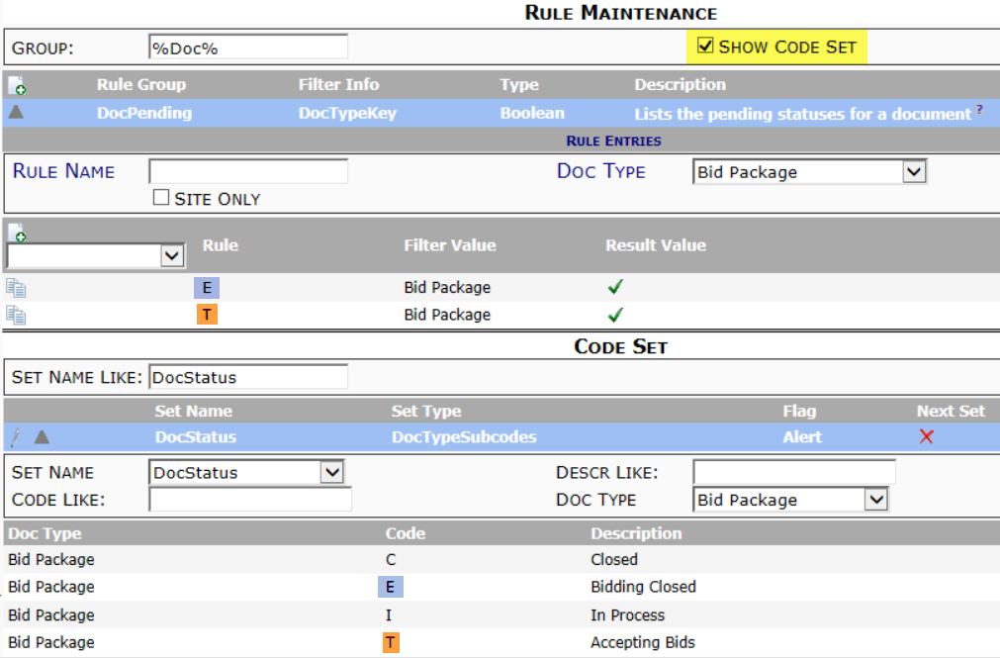
Codes As Rules
Use the Show Code Set filter

Slide 13
DocItemConfig | DefaultRevisionNumber
Sets the starting Item Revision number to 0 or 1 (useful on Submittals)

Slide 14
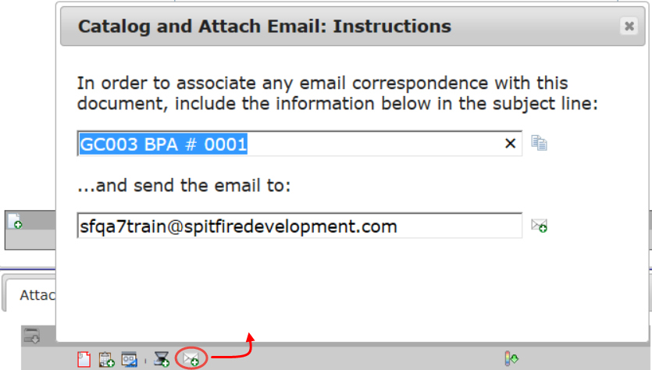
DocTypeConfig | EmailShortID
Identifies Doc types for inbound email using short IDs

Slide 15
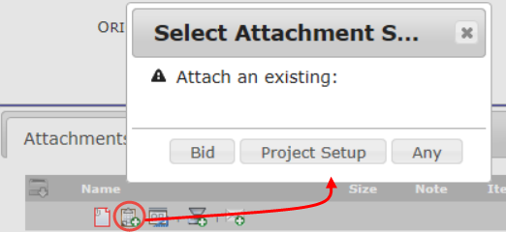
DocTypeConfig | ExpressDocAttachList
Lists Doc types (by GUID, from Doc Types Tool) to appear on document’s “Attach Doc” icon

Slide 16
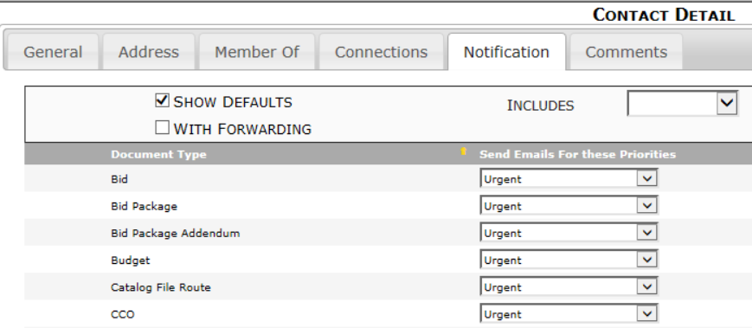
EmailText | NotifyOver
Changes the defaults on the Contact Notification tab for non-users

Slide 17
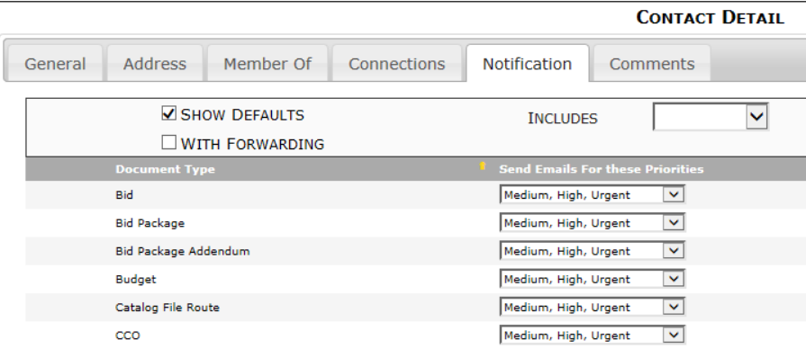
EmailText | NotifyUserOver
Changes the defaults on the Contact Notification tab for Spitfire users

Slide 18
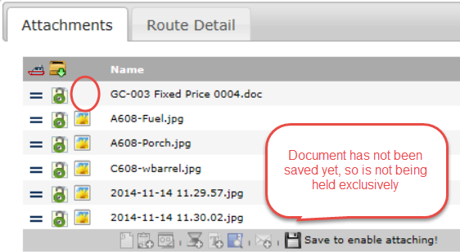
FileCatalogConfig | AutoLockAttachments
Prevents users who do not have exclusive access to a document from viewing or editing files attached to that document.

Slide 19
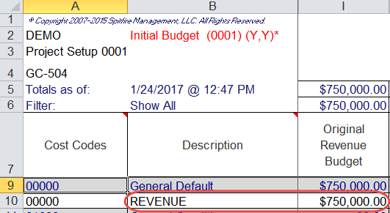
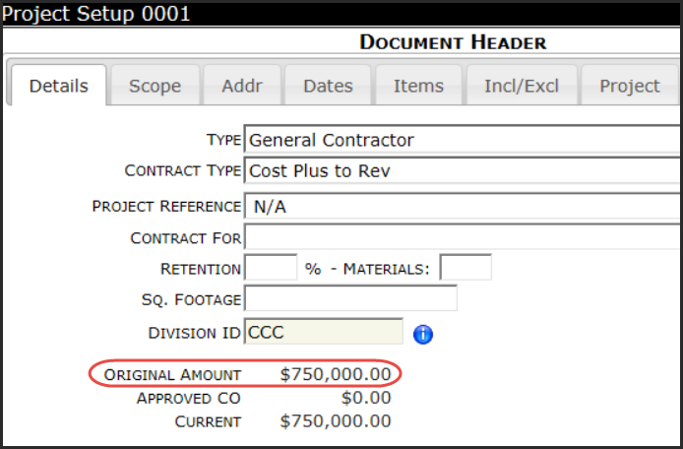
ProjectConfig | InferValueFromBudget
Fills in the Project Setup’s original amount from the project’s approved budget

Slide 20
RouteConfig | AutoResponsibleParty
Sets the document’s Responsible Party based on the current routee’s company.
You could then show Responsible on the Doc list:

Slide 21
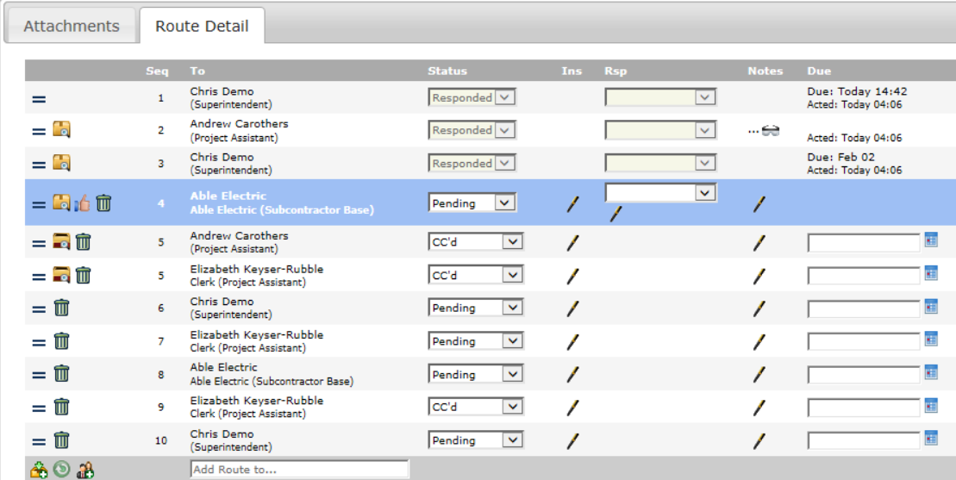
RouteConfig | ShowMaximized
Shows the Route Detail tab always maximized

Slide 22
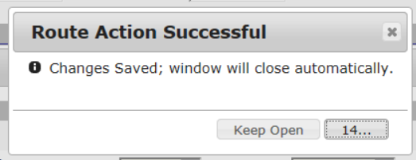
RouteConfig | ThumbUpDismissSeconds
Sets how long the Route Action Successful dialog box remains open after a “thumbs up”

Slide 23
Next Topic
Putting It All Together (Quote to Budget to Billing)
March 9th – 1:00 pm EST
Other Webinars Coming Soon:
Outbound Email – Personalized for Your Company
Working with Projects and Sub Projects
All About File: Copy vs. Clone and Cloud Sync

