Slide 1
Designing Your Own Catalog Tab
Client Webinar Series
Time to Reach New Heights
June 8, 2017

Slide 2
Agenda
KBA-01564: Overview of the PresetSearch Rules
KBA-01598: Creating Your Own Catalog Search Tabs
We’ll Go Over …
What is a PresetSearch Catalog
Limit by:
Doc Type (can include Subtype)
Folder
Project ID or Project Mask
Access to the Catalog Page
By Role
Display
Always There
Open and Close when required

Slide 3
Create the Tab
Always Displayed
Add in Site Config
Choose to Display and Choose to Close
Create in Rule Maintenance | PresetSearch

Slide 4
Always – Add to Site Config
Only change the text in Red Italic
<TabInfo> < PageName>Desktop</PageName> < TabBarName>Banner</TabBarName> < TabID>922</TabID> < TabName>View</TabName> < TabOrder>111</TabOrder> < Roles>LibView.aspx</Roles> < Url>~/dcmodules/libview.aspx?set=cv</Url> < Tip>Custom Library</Tip>
< /TabInfo>
<TabInfo> < PageName> < TabBarName> < TabID> unique over 900 < TabName> your Tab Name < TabOrder> < Roles> see below < Url>your tab’s filter value < Tip>Tool Tip
< /TabInfo>
Roles:
LibView.aspx is the Catalog Dashboard – use this one if you want anyone who can access the Catalog Dashboard to access your PresetSearch Cataloh Tab
Or – use any of the capabilities in the UCModule=PAGE in the xsfUCFunction table
For example: cuManager.aspx = Manage tab

Slide 5
Display in Catalog drop-down list
Add a TabKey (defines your “filter”)
TabKey | cv | 1
Add a PageTitle (name for your tab)
PageTitle | cv | Get Started
Now you have a Catalog tab – but there’s nothing on it

Slide 6
What’s the Focus - Docs or Folders?
What’s the Focus
Documents | cbid | ☑
Specific Doc Type (or Doc Type/Subtype) DocType | cbid | Customer Bid
Optional: Specify Subtype(s) Subtype | cbid | CP,FP (enter the Codes with commas but no spaces)
Or
Files | cv | ☑
Files in a specific Folder Folder | cv | /Getting Started
Allow User to drag-and-drop files to your folder FileDrop | cv | ☑

Slide 7
More details
General
Visible To - specify roles or Login Names Examples: Everyone, Internal Staff, BETTYR
DaysAgo – how far back (default is 366)

Slide 8
Sorting
Documents
Default = DocDate DESC, Title
SortDocs options
DocDate
Due
Title
DocTypeKey
DocNo
Project
ProjectName
DocReference
FromUser
SourceContact
StatusText
Files
Default = FileName
SortFiles
Catalogued
ReferenceDate
FileName
ProjectName
SourceContact
Keyword

Slide 9
Lock
Your goal is to create a quick reference, not recreate the Catalog tab…
You can think of this two ways:
What Catalog options don’t you want the user to change
What Catalog options do you want to hide so the user doesn’t have to deal with a lot of choices/clutter
Lock allows you to remove (hide) some of the Catalog search options, for example:
Closed (Include Closed option)
Documents (on a File tab, you may want to block the user from clicking Include Documents)
Project
Doc Status
And so on.

Slide 10
Example: Custom Bid Files

Slide 11
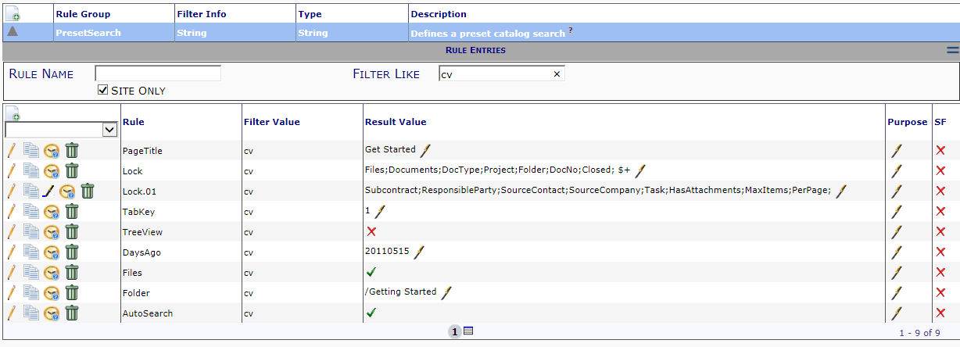
Example: Get Started

Slide 12
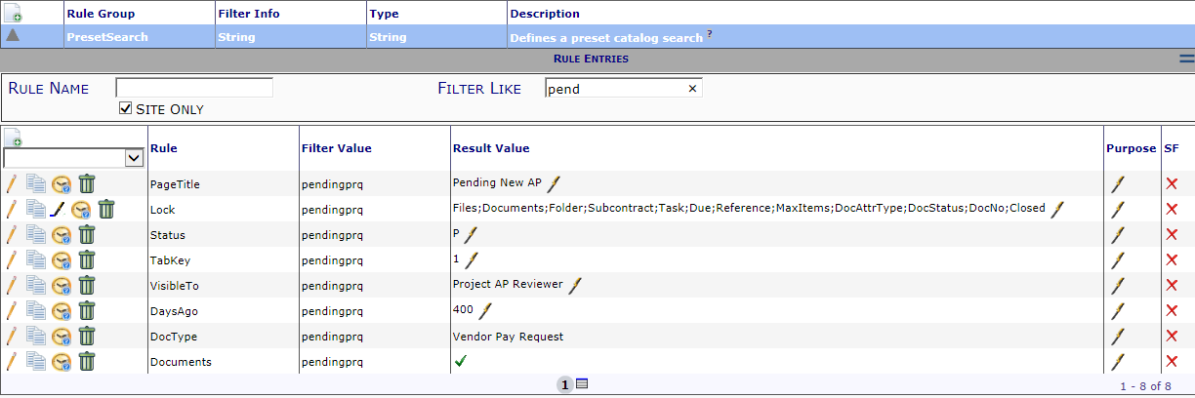
Example: Pending Pay Requests

Slide 13
Example: Java Script Files

Slide 14
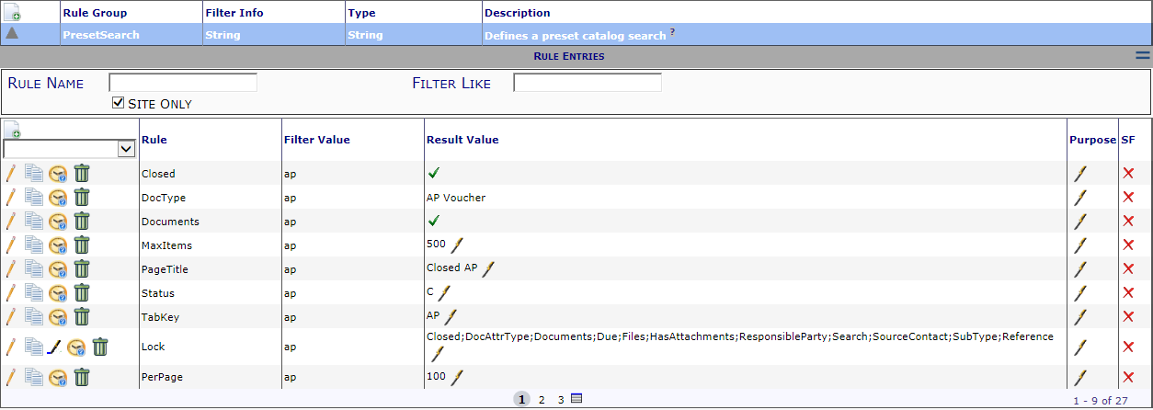
Example: Closed AP Vouchers

Slide 15
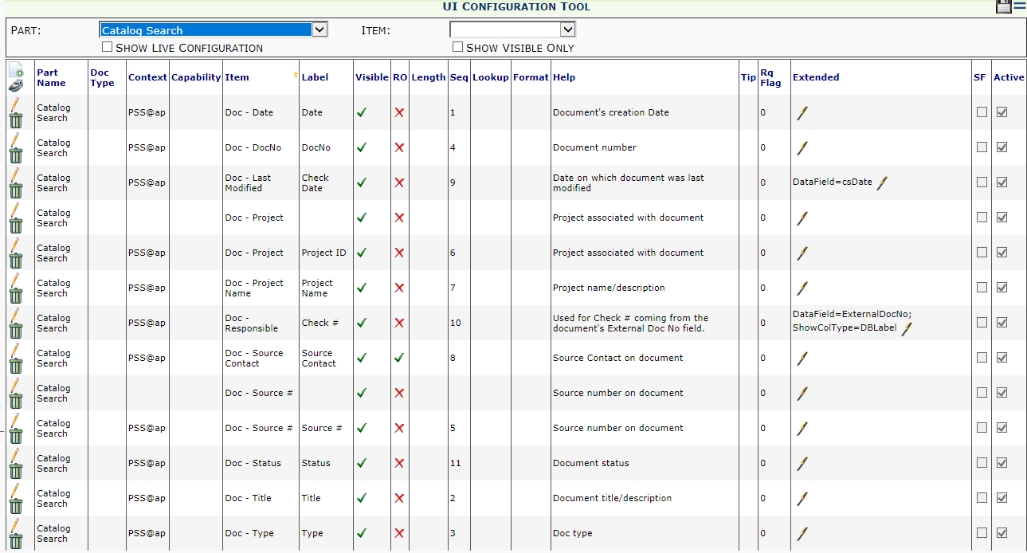
Example: Closed AP Voucher
UI Configuration
Add your Tab “filter” in the Context column
PSS@xxx
(substitute your Tab filter for the xxx)

Slide 16
Next Topic
Project Tiers (Project Links/Sub Projects)
July 13th – 1:00 pm EDT
Be sure to check your Inbox for the Spitfire Monthly Newsletter; it’s full of tips and info on our newest features.
Not receiving our newsletter? Just send an email to support@spitfiremanagement.com and we’ll add you to the list.

