Slide 1
Branding Your Outbound Email
Client Webinar Series
Time to Reach New Heights
August 10, 2017

Slide 2
Agenda
We’ll Go Over …
Email Body Templates
Email Text Rules
Echo Format
IER responses
Routed Subject
Routed Msg
LinkTo
Signature Format
Route Via Preference vs. Predefined Route settings
Direct Inbound

Slide 3
Email Body Templates
Convert your Word Template into an Email Body template
Email Body template are created in Word – just like the Attachment, Attachment(auto), and Attachment(all) templates, but… …instead of being delivered to the recipient as a pdf file or a Word file attached to the email … …the Email Body template is printed as the body of the email
The recipient reads the content immediately
Don’t underestimate visual impact – your recipient will be reading your email before he or she actually opens it

Slide 4
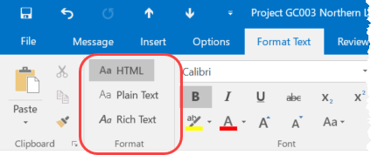
Email Body Template Tips
Email Body Templates do not get delivered as a Word document or a pdf file, but as HTML
The concept of “pages” does not exist
No “Header” or “Footer” or Page Number
No Page Breaks
Do not use an Email Body Template for formal documents like a subcontract
Use Email Body Templates for your shorter, Q&A type communications or announcements and notices
Also Note:
EmailText | RoutedMsg do not get included
Routee Instructions from the Route Grid do not get included
Link to download additional content can be included
Link to Response Wizard can be included
EmailText | SignatureFormat does apply unless you disable the rule

Slide 5
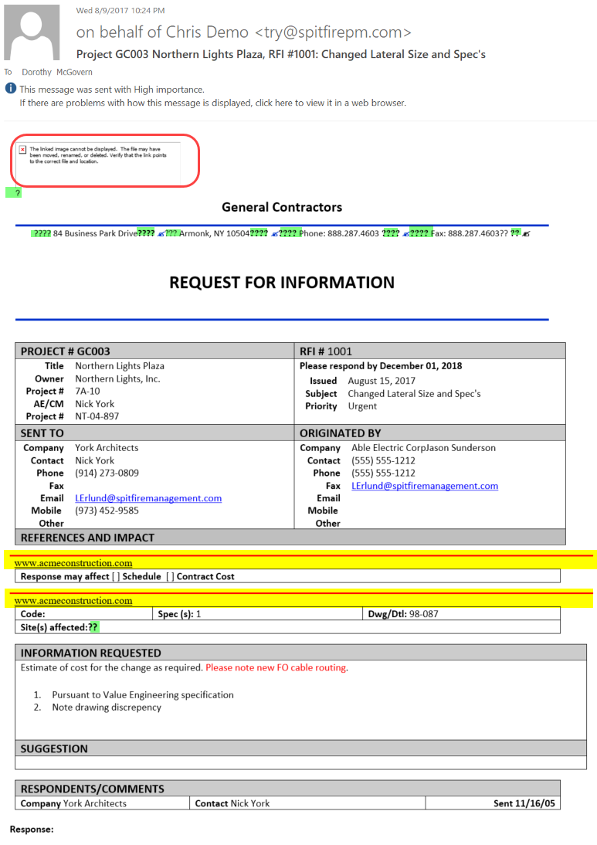
Email Body Template Edit Tips
What happened to my Logo
If you used the qImg_Logo bookmark to pull the logo, the link back to the logo is broken. In the email body template just include your logo in the template
What are all those ????
Extra spaces – HTML only recognizes 1 space
If you type 4 spaces, you’ll see ??? (a space with 3 question marks)
Where did the red lines with the url come from?
If you original Word template had a footer, HTML will try to use it at any break (page break, section break)
Use the Word Inspector to find and delete hidden bookmarks

Slide 6
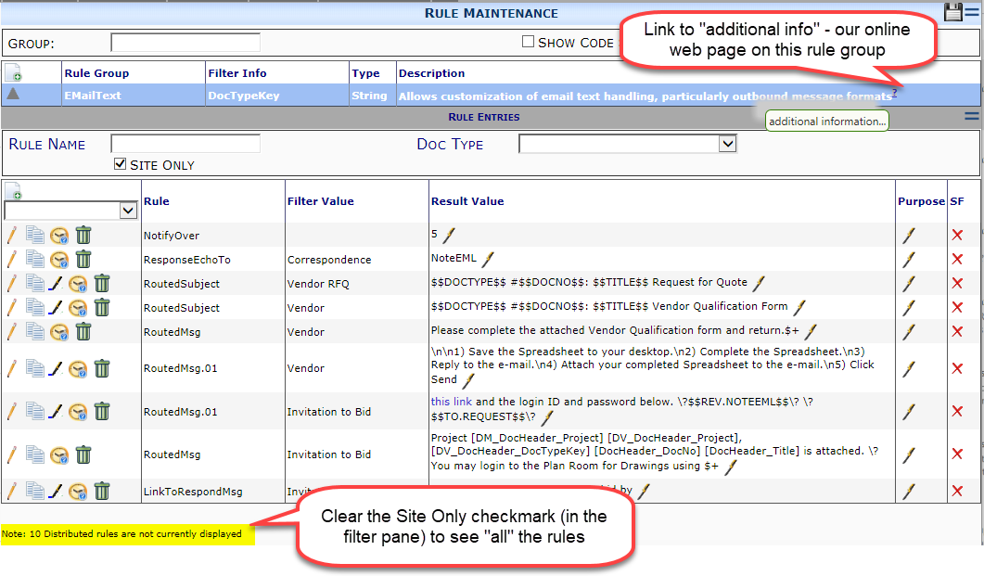
EmailText rules
System Admin | Rules Maintenance | EmailText

Slide 7
Inbound Email Response: IERxxxx
When you order from Amazon, or Pottery Barn, or Wayfair, etc., you expect a confirmation to be sent to your email. It’s become “expected” for online communications.
Spitfire includes several automated responses that let the email sender know that he or her response has been received.
Check out the IERxxx message and tailor it to your requirements.
For example, change the text to a simple “Thank you for your response.”

Slide 8
EchoFormat
When an inbound email response is received, the sender’s response is added to the Route’s Response field – but you can configure the EmailText | ResponseEchoTo rule to also add the text to one of these locations:
Note = copy the Rsp field to the top note field.
NoteA = copy the Rsp field to the middle note field.
NoteB = copy the Rsp field to the bottom note field.
NoteEML = copy the Rsp field to the message note field on the Message (Email) tab
0 = do not copy is the default -or try RouteConfig | ManualEcho
Specifies (in the result value checkbox) whether the system provides a button to copy the route response to the field identified in EmailText | ResponseEchoTo. After it has been copied, the note can be edited.
unchecked = No (default).
checked = Yes.

Slide 9
RoutedSubject
Information in the Email Subject Line
Recommended:
Project, DocType, DocNo, …..
Why?
Spitfire embeds data in the email header or body so that the email reply can be directed back to the document from which it was sent … …BUT some email engines will strip that data out of the email
Project, DocType, DocNo can be used to find the Spitfire document
Default includes: “Project”, Project ID, Project Name, Doc Type, “#”, Doc Number,”:” Document Title (the text in black without a highlight is a literal)

Slide 10
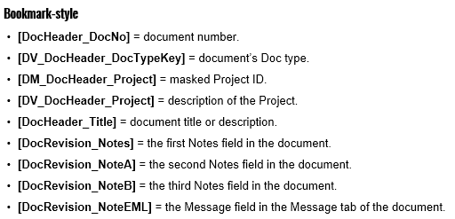
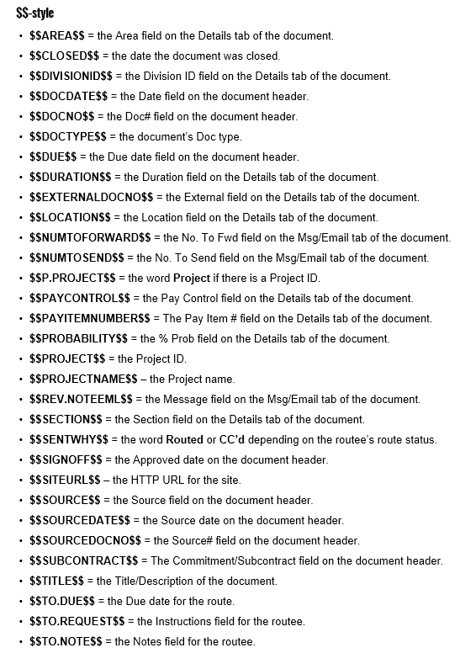
RoutedSubject
Placeholders
Like a bookmark in a template, the placeholder will be replaced by the data in your Spitfire document
Two styles of placeholders
Bookmarks
$$
Text
Filter for Doc Type

Slide 11
RoutedMsg / RoutedMsgCC
Note: If you use an EmailBody template, the RoutedMsg rule does not apply. And the Routee Instructions will not be included in your email. Your template should include all the information you wish to include in the email body.
Uses both Placeholder styles
Can be expanded to multiple line item entries for a longer message
CC Recipients can receive a different Routed Message
If you add an Instruction for the Routee – this personal instruction will be included below the RoutedMsg

Slide 12
LinkTo…
LinkTo types:
Related Rules to Configure LinkTo
Content
Download Files
Doc
Spitfire Document – requires Spitfire Login to access and open the document
Respond
Response Tip and link to Response Wizard
SendFiles
Link to upload files
LinkToxxxMsg/MsgCC
“You may record your response by replying to this email and/or by”
LinkToxxxFormat/FormatCC
{0} {1} {0}=Msg {1}=Tag
LinkToxxxTag/TagCC
using this link

Slide 13
Signature Format
If you include a “signature” in your EmailBody template, then you will want to disable the EmailText default
To disable, enter SignatureFormat | DocType | 0
If you want to configure the Signature use these codes
{0} = the sender name (e.g., John Smith)
{1} = a line break
{2} = the sender title (e.g., Project Manager)
{3} = the sender company or, if no company, the name again
{4} = the sender phone number
The default is {0}{1}{2}{3}{4}{1} : Sender Name John Smith Sender Title Project Manager Sender Company Spitfire Construction Sender Phone (203) 952-6552

Slide 14
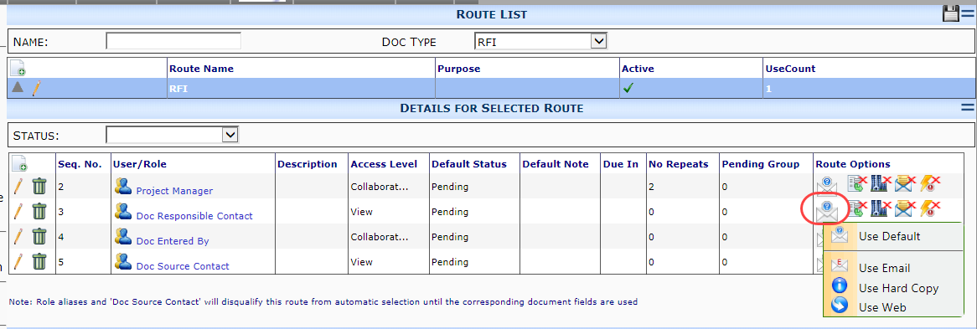
Preferred Route Via
Prior to the addition of the Preferred Route Via options only three options were available:
The Contact Record’s Route Via setting
The Routee’s Option menu on the sfDoc’s RouteDetail grid
Web (conditional) on the Contact Record’s Route Via allowed you designate which Doc Types would email vs. web for all your Web (conditional) contacts.
Predefined Routes now include the Preferred Route Via option that can be set for each routee line and your choice will override the Contact Record’s Route Via

Slide 15
Direct Inbound
Direct Inbound is used when a specific Doc Type is better suited to an email conversation back-and-forth with two or more parties.
Direct Inbound replaces the predefined route and just tracks and stores the emails as then go back-and-forth in your email application.
To make it work:
Designate the Doc Type as Direct Inbound EmailText rules DirectInbound | DocType | Yes, No, Smart If not a reply to a specific sfDoc Yes – create a new Doc of this DocType No – do not create a new Doc of this Type, but create a Correspondence Doc Smart -
Include your Spitfire email pop account on your email (To or CC’d)
Include Project ID, Doc Type, Doc No is your email subject
Spitfire considers these email as unsolicited email – so you will need to set your “unsolicited” email setting in ICTOOL
Four settings: Accept All, Reject All, @Company Whitelist (any person from a company that is include in your Spitfire Contacts dashboard), Individual Whitelist (any person included in your Spitfire Contacts dashboard)

Slide 16
Next Topics
Organize Your Data
September 14th – 1:00 pm EDT
Spitfire Version 2017 Preview
October 12th – two sessions
11:00 am EDT – 1:00 pm EDT

