Slide 1
Organizing Your Data
Client Webinar Series
Time to Reach New Heights
September 14, 2017

Slide 2
Agenda
We’ll Go Over …
Programs
Subtypes/Project Types
Doc Reference/Global Reference
CSI Code for Vendors
Item Types
Catalog Folders
Report Folders
Roles & SubRoles
UI Capabilities

Slide 3
Programs
Programs can group like projects – used in searches, reports, Executive Dashboard
Create a Program
Add Projects to a Program
Projects can be in Multiple Programs
Executive Dashboard and Project Log report
Examples:
Insurance – groups all the projects that were paid for by the owners insurance claim
Region or Sales Territory – groups projects by Regional Supervisor/Executive, or Sales Manager

Slide 4
Subtype / Project Types
Subtype field allows for variation of Doc Types
Subtypes can be used for selecting:
Templates
Catalog Folders
Routes
Field visibility on a doc type

Slide 5
UI Configuration
Choose which fields to display based on Subtype

Slide 6
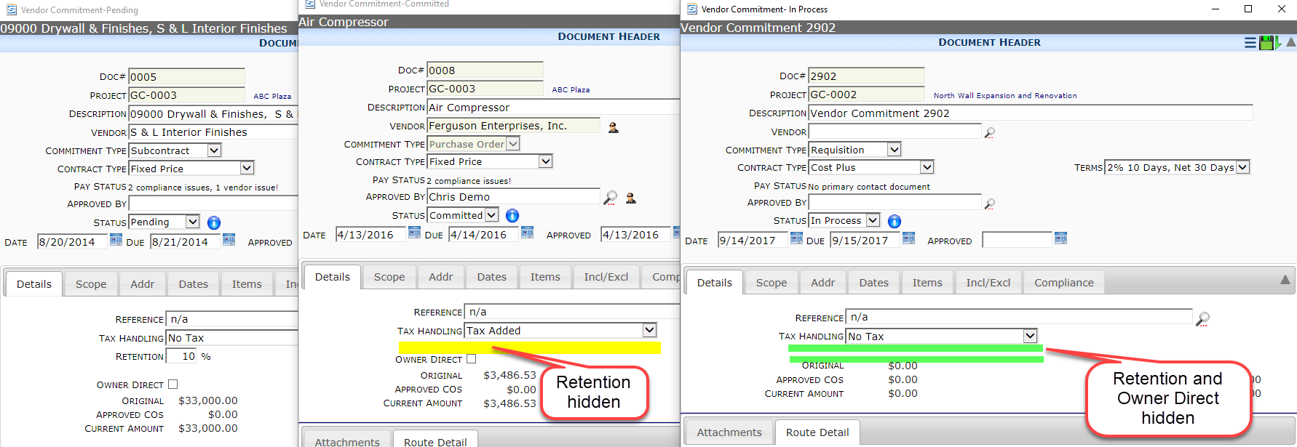
UI Configuration
Choose which fields to display based on Subtype

Slide 7
Doc Reference / Global Reference
Reference was designed as a free-form organization tool for you
Each Doc Type has both a Doc Reference and a Global Reference field available for use.
Both Global Reference and Doc Reference can be used when creating selection criteria for Predefined Routes
Doc Reference can be used as selection criteria for Templates

Slide 8
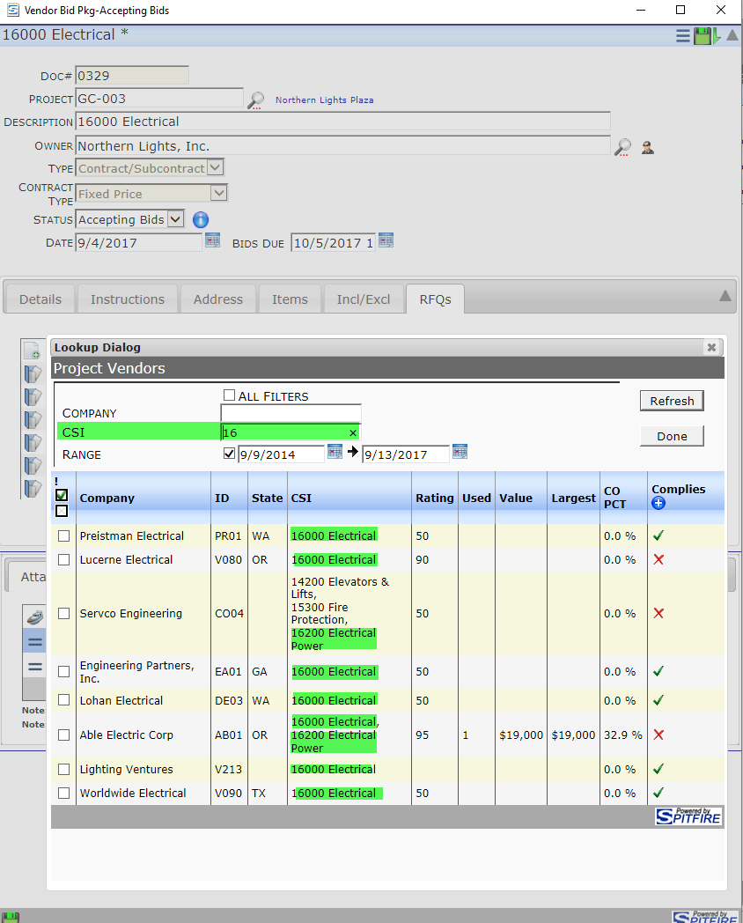
CSI Maintenance
CSI Maintenance is use primarily for Vendor Specialties
Create your CSI list in Manage | CSI Maintenance
Apply one or several CSI Codes to your Vendors
Searching for a Project Vendor with a specialty – enter a CSI Code in the Filter Criteria

Slide 9
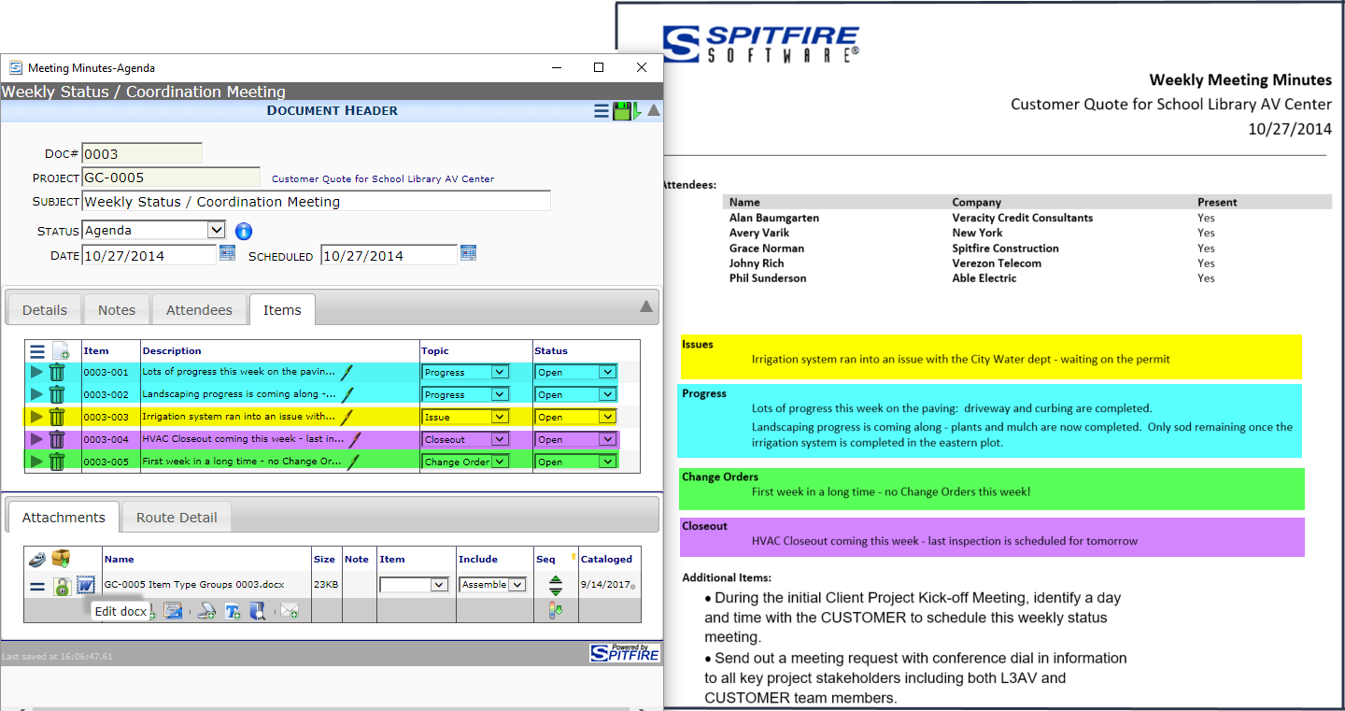
Item Types
Item Types allow for grouping of items on templates.

Slide 10
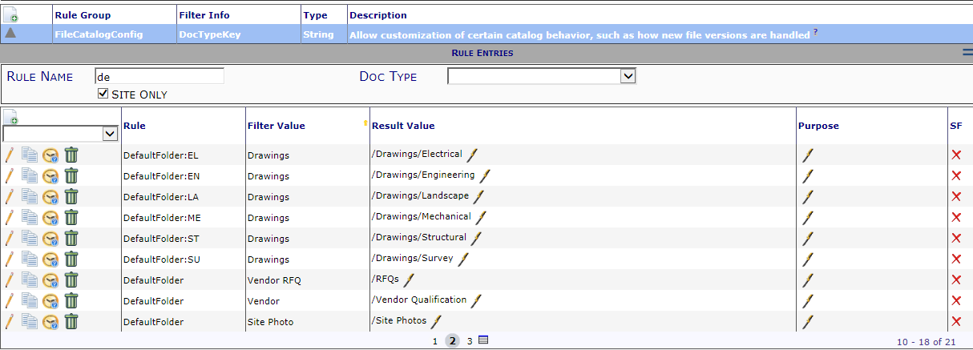
Catalog Folders – Organize your Files
Catalog folders are User Defined and Access is based on Roles
Create your Catalog Folders
Catalog Folders can be nested 8 levels deep
Use FileCatalogConfig rule group to select a default folder for each DocType or DocType/SubType combination

Slide 11
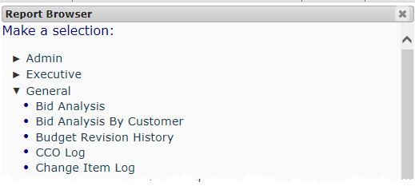
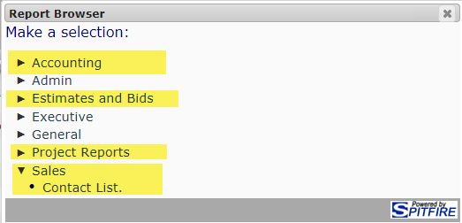
Report Folders
Group reports by Roles
Spitfire ships our reports in 4 folders
_Library: all the reports and subreports (not displayed in the Report Browsers - only visible in SSRS)
Admin: linked reports for Admins
Executive: linked reports for Executive – mainly cross-project reports
General: linked reports for all users – mainly project reports
Consider packaging the reports by Function or Responsibility
Projects
Accounting
Estimating/Bids

Slide 12
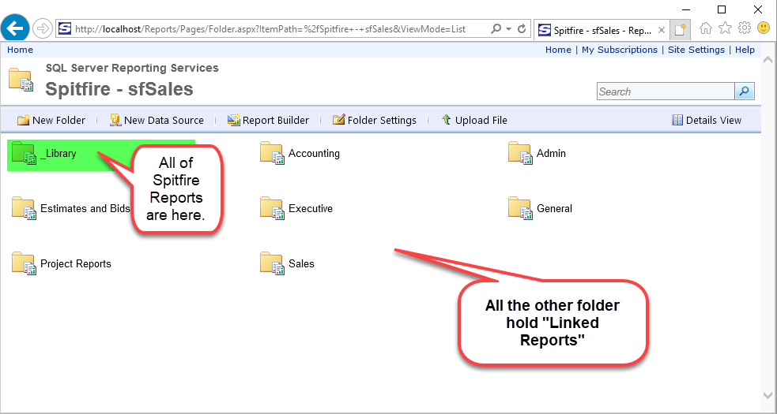
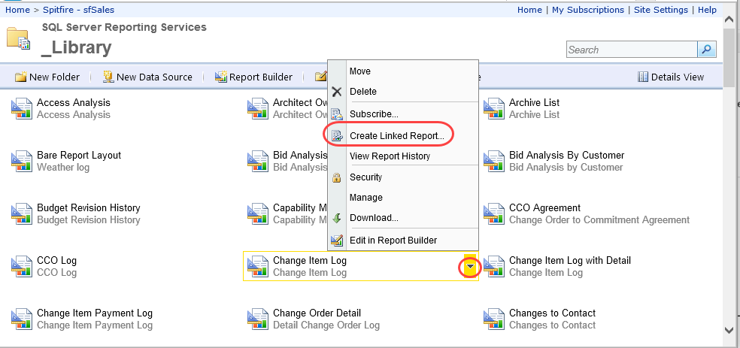
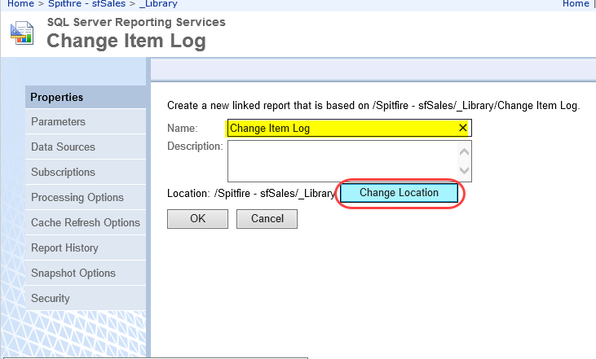
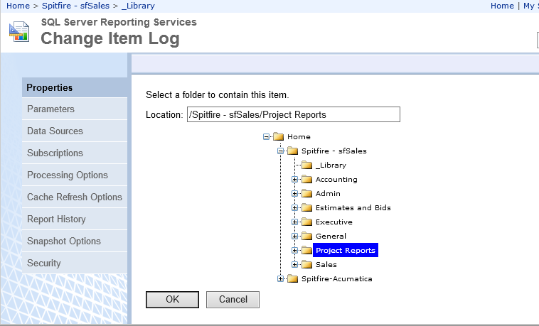
Report Folders
Open the IE Brower using “Run as Administrator
Create your Folder
In _Library folder, click on the report you’d like in your new Folder and choose Create Linked Report
Enter the Report Name
Change Location
Select your folder
Click OK

Slide 13
Roles & SubRoles
Subroles can be used to create a base for multiple roles
For example:
Subcontractor base can be the Subrole in the almost any “external” user Primary Role
Create an Architect/Design Professional subrole and then assign to Architect role, Design Professional role,
Maybe an ArchitectNR role (NR for No Routing) for the Architect Principal who will log in as a web user to review the project but doesn’t want to be included on all the day-to-day emails.

Slide 14
Next Topics
Spitfire Version 2017 Preview
October 12th – two sessions
11:00 am EDT – 1:00 pm EDT

